Slide 1
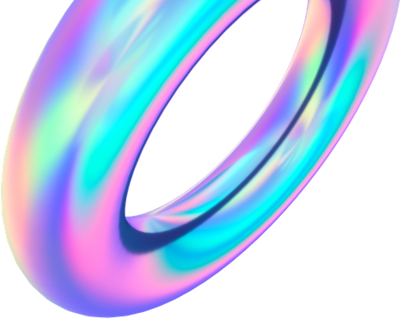
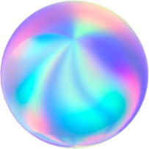
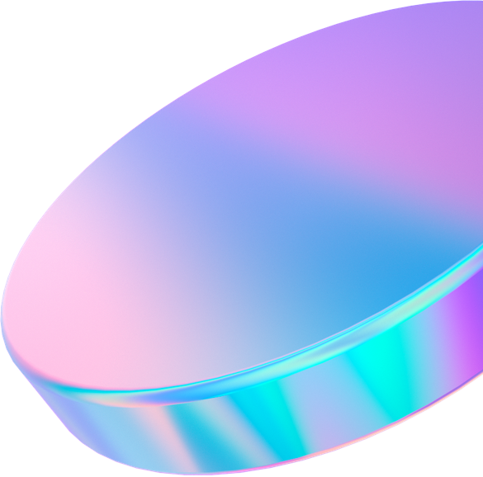
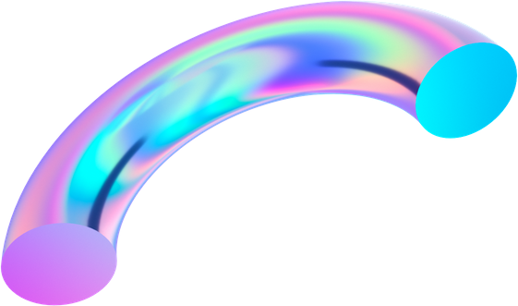
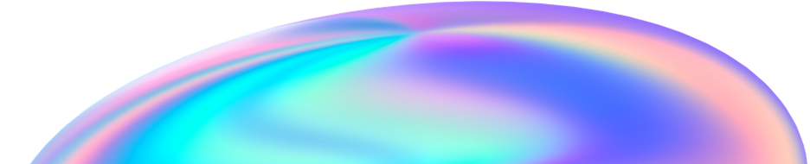
IT PROJECT
HEALTHCARE APP

Slide 2

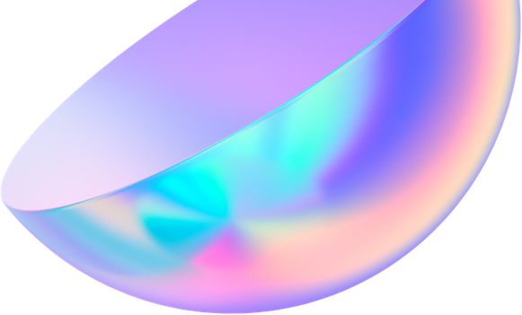
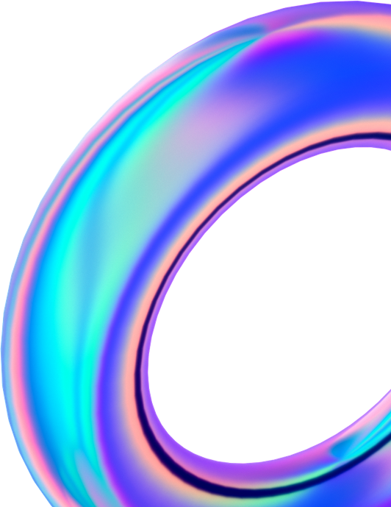
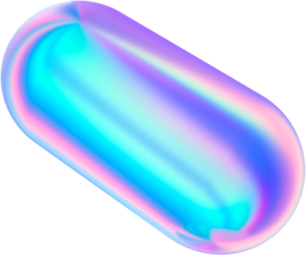
INTRODUCTION

Slide 3
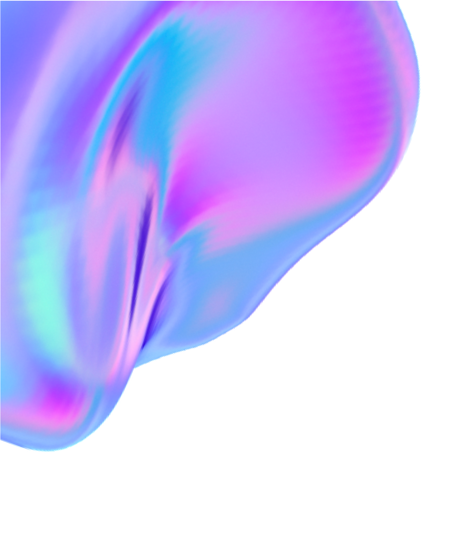
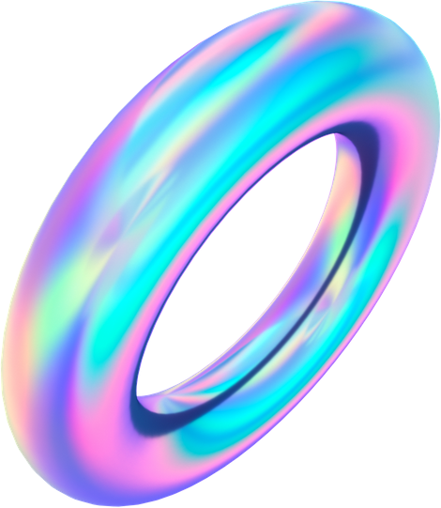
To start a good life, healthcare is more important. Nowadays Health-care Environment has developed science and knowledge. Recently, we all have witnessed the covid pandemic that has put immense pressure on health systems all over the world and hospitals have been overwhelmed with patients, in such conditions it is very difficult to obtain the consultation with the doctor in case of any health issues. As more and more people start to use web, they may provide a tool to help improve a patient's health and fitness. Specifically, applications or “apps” on computers are programs that use data collected from a computer's inbuilt tools, such as microphone, speaker, and camera, to measure health and fitness parameters. The proposed idea is to create a health care app system using python programming that can be used to know disease by the symptoms in a person and provide basic details about the disease before consulting a doctor. The app then analyze these data and summarize them, as well as devise individualized plans based on users' goals, provide frequent feedback, personalized coaching, and additional motivation by allowing milestones to be shared on social media. Healthcare apps are becoming a reality for users. Patients are facing a problematic situation of unforeseen demise which is because of nonexistence of good medical maintenance to patients at the needed time. So we are proposing an innovative project to provide all the needed information on specific diseases from your home in case of problems.

Slide 4
FLOWCHART
ANALYSIS
DESIGN
PROCEDURE AND CONSTRUCTION TESTING
MAINTENANCE

Slide 5
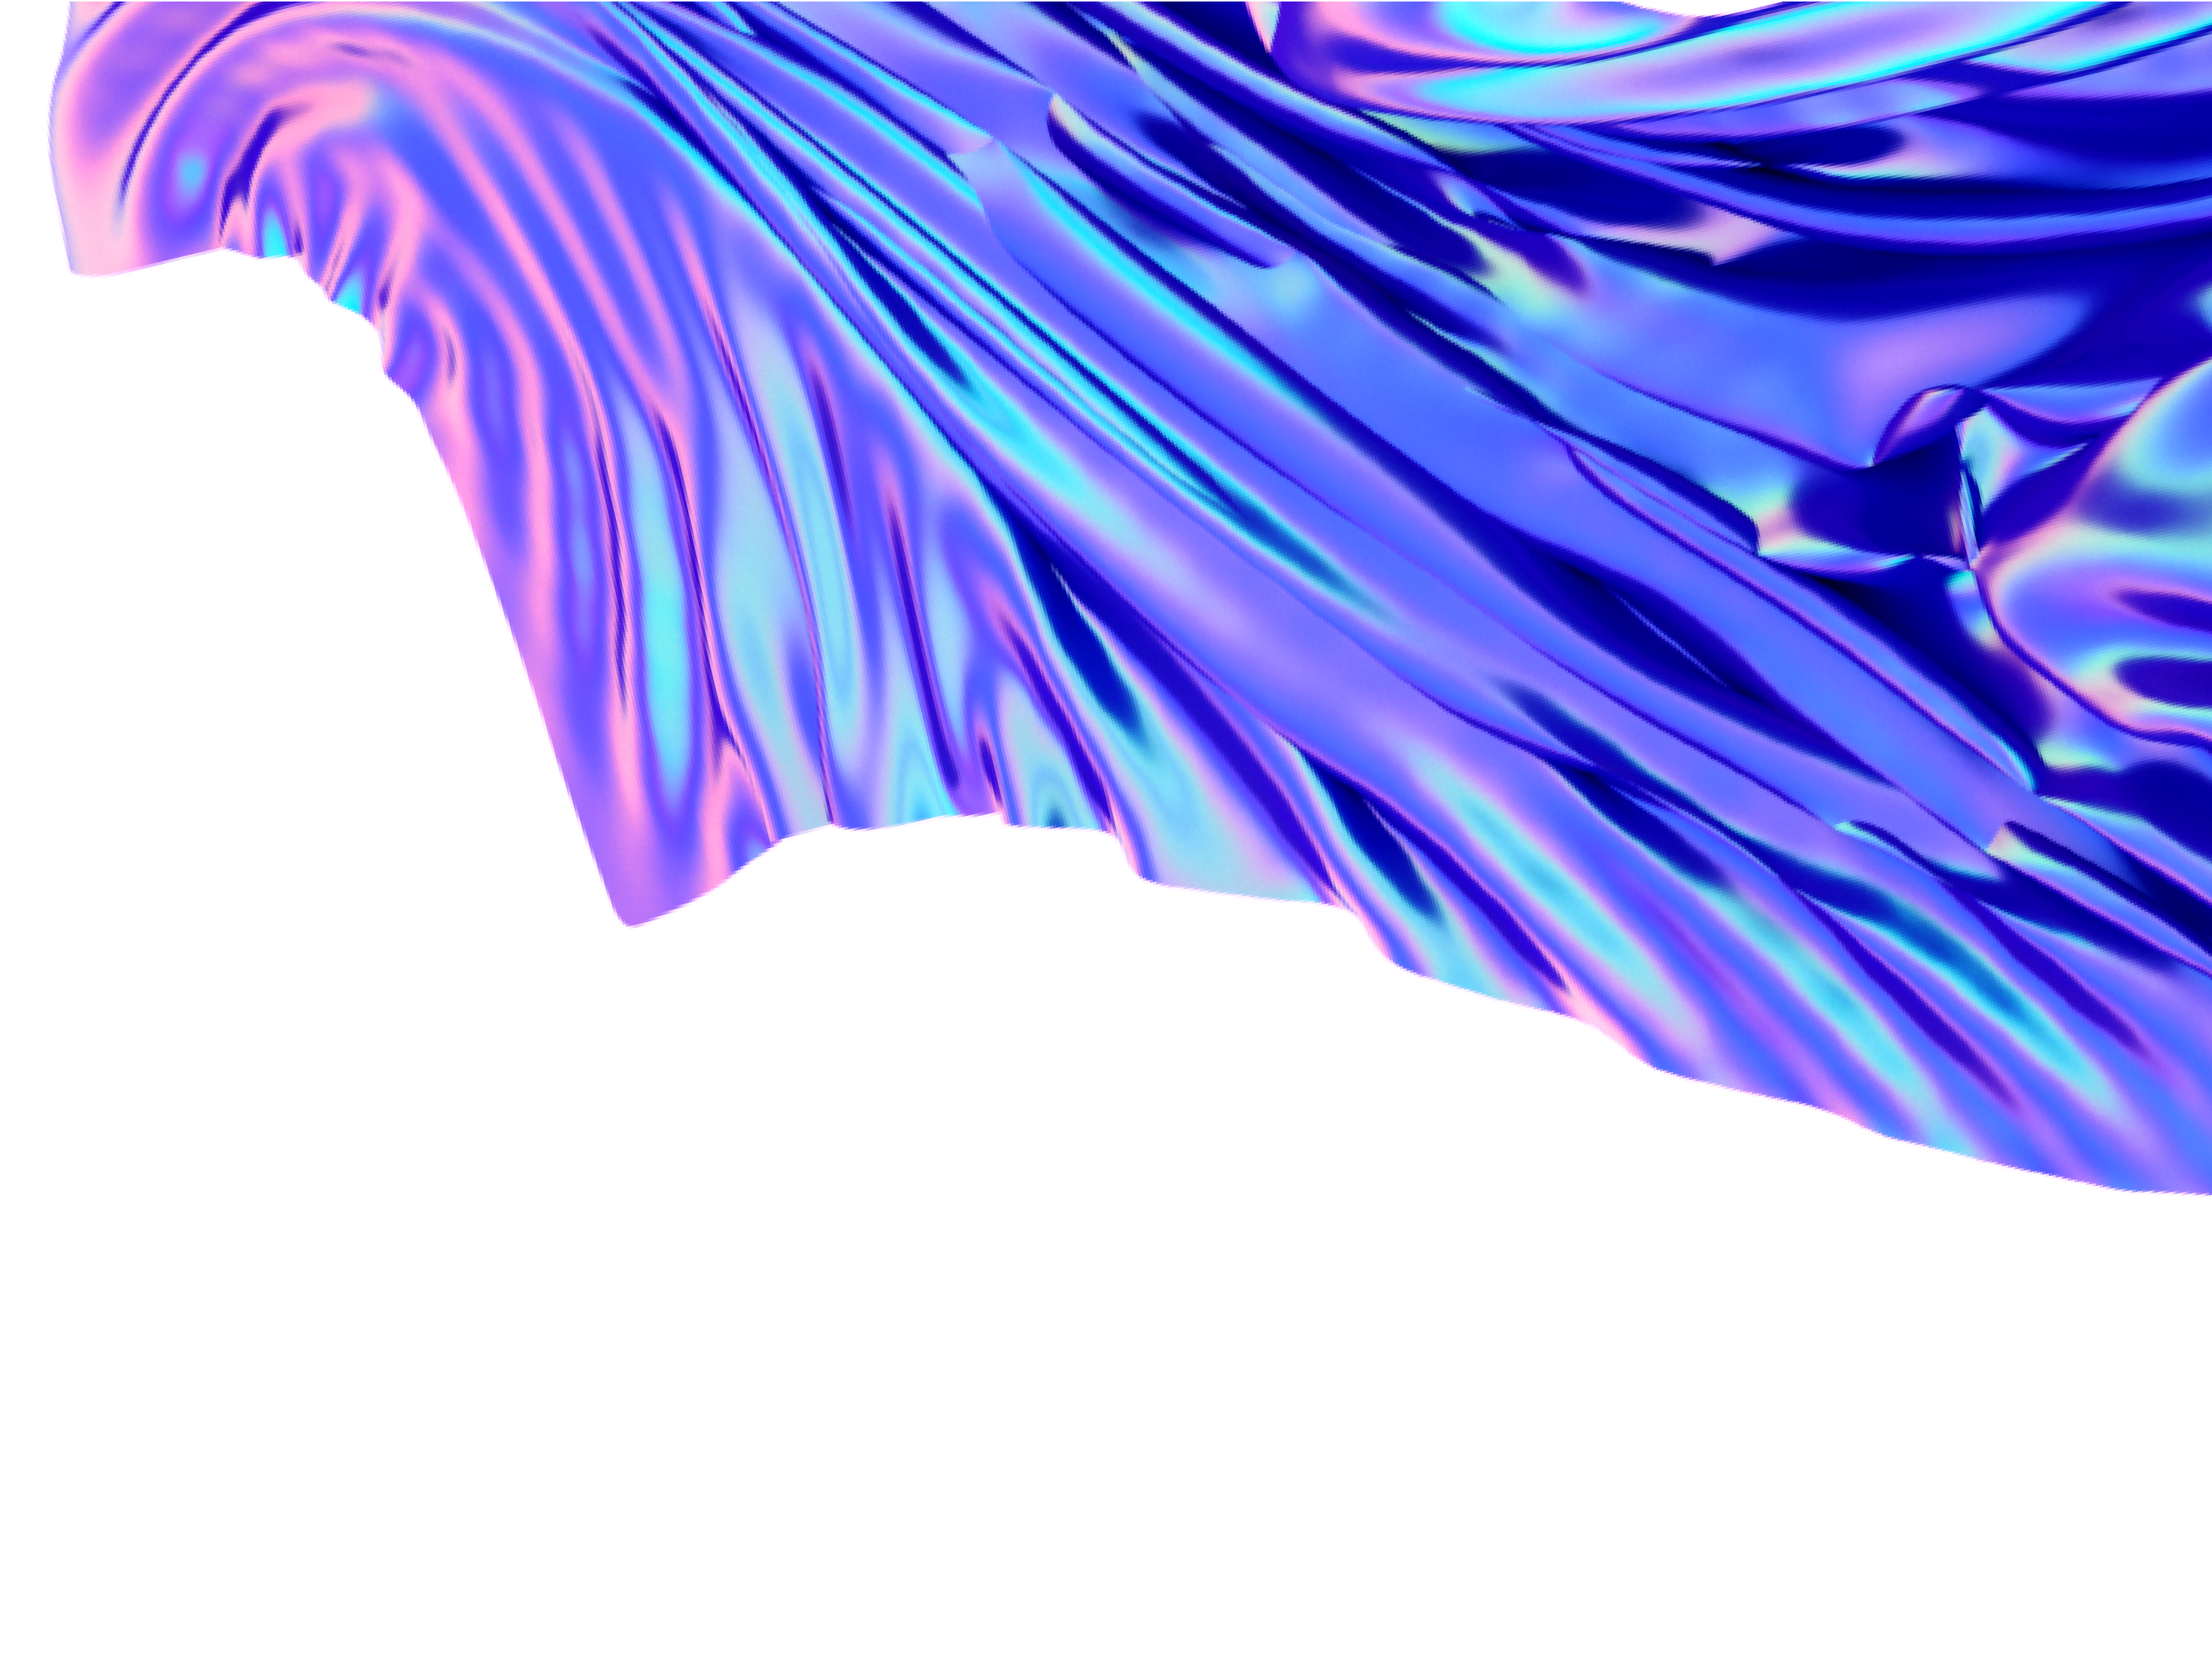

ANALYSIS
As we are going to make an healthcare app, our team analyzed the project thoroughly and by analyses we selected following features to be included in the app which is needed by today’s generation.
The Features of our app are as follows:
Symptoms and diseases
Links of various websites /resources
Data or statistics of no. of COVID-19 cases
Positive quotes/health related facts
Notification and Reminder Feature for medicine
Suggestion for doctors
Easy registration and login

Slide 6
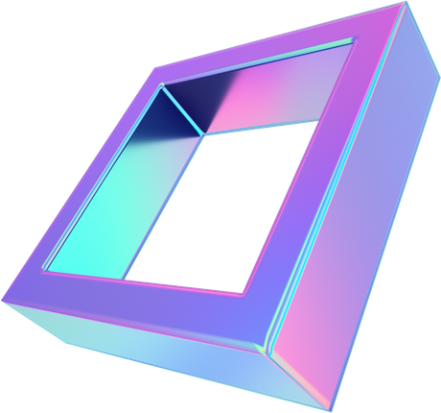
1. Chatbot Window
It is a basic chatbot window which will guide the user.
DESIGN
Our team has decided to make the project (health care app) in python language using Tkinter. The design of our app is going to be simple and easy to use. In our app first there is going to be a login page where the user can easily login and create their profile and
2. Daily updated data of covid
It will give daily updated Covid data of the World and India as well.
3. Link of health related websites and resources
It will provide all the news and useful links for users
can also access them
later whenever going to be a
needed. Then there is
Health facts and home remedies
Knowing about our own body in life is very important. Health facts will let the users know more about it and home remedies will help them to cure themselves till the time they can't reach to any doctors.
Reminder
It will ask the user for reminder and set the reminders for the user.
dashboard and home screen. In home screen there going to be different options where the user
can choose from.

Slide 7
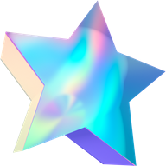
1. Tkinter
Tkinter is the standard GUI library for Python. It provides a fast and easy way to create GUI applications and provides a powerful object-oriented interface to the Tk GUI toolkit.We used it in our app to create the whole Body structure of our app.
METHODS AND PROCEDURE
Following are the technologies that we have used in our project:
2. Covid
It is a Python package to get information regarding the novel corona virus provided by Johns Hopkins university and worldometers.info. We used it in our app to get the latest updated COVID info.
1.App Development 2.Python 3.Tkinter(GUI) 4.Web Scrapping
3. Plyer
Plyer module is used to access the features of the hardware. We used it to add notification feature in our app and to show the notifications on our device.

Slide 8
4. Time
7. OS
OS module in Python provides functions for interacting with the operating system It provides functions for creating and removing a directory (folder), fetching its contents, changing and identifying the current directory, etc.We used it in our CHATBOT.
Python time module provides many ways of representing time in code, such as objects, numbers, and strings. It also provides functionality other than representing time, like waiting during code execution and measuring the
efficiency of your code.We used it in our app's notification feature.
5. Numpy
it is a general-purpose array-processing package. It provides a high-performance multidimensional array object, and tools for working with these arrays. It is the
8. We browser
The We browser module provides a high-level interface to allow displaying Web-based documents to users. In our app it help us to display the desired webpages.
fundamental package for scientific computing with Python.
6. Pandas
It provides ready to use high-performance data structures and data analysis tools and it is popularly used for data science and data analytics.
9. Matplotlib
Matplotlib is a cross-platform, data visualization and graphical plotting library for Python and its numerical extension NumPy.It offers a viable open source alternative to MATLAB. Developers can also use matplotlib’s APIs (Application Programming Interfaces) to embed plots in GUI applications.

Slide 9

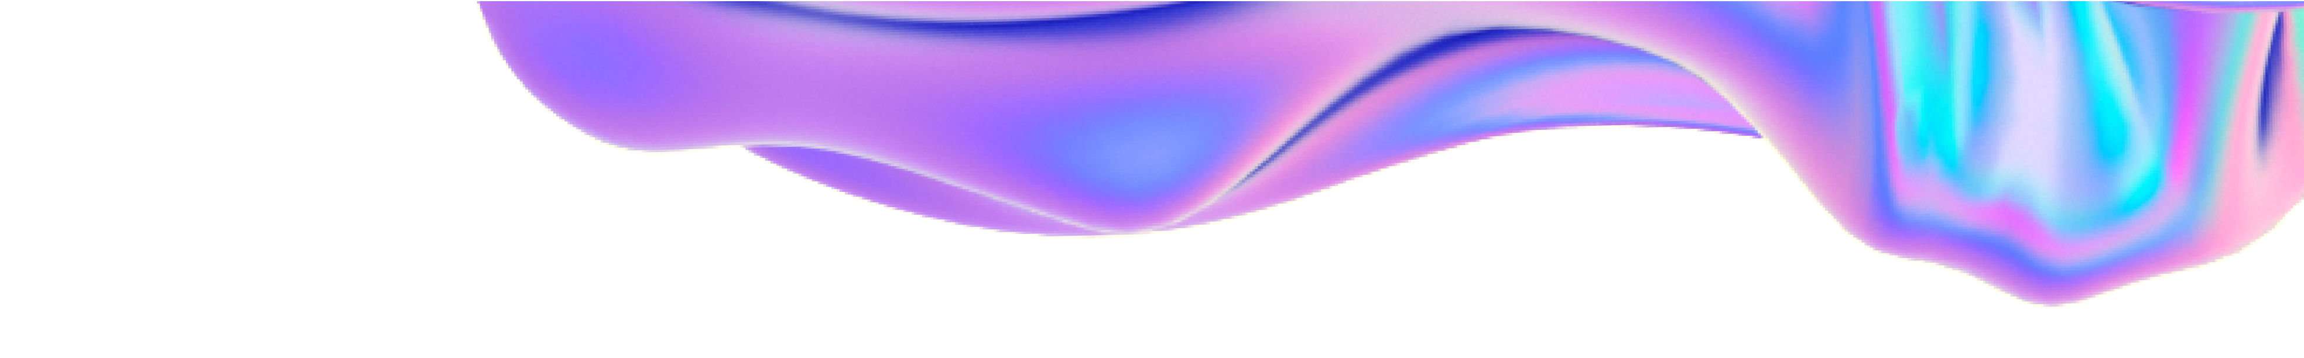

CHALLENGES FACED
Following are the challenges our team faced while designing the application:
The logo of the app took a lot of our time while deciding the primary structure of the application. Taking the theme of the app (healthcare) into consideration, we decided the color combination of peaceful, calm and gentle colors which have power to manage stress, slow down the heart rate, lower the blood pressure and reduce anxiety.
The wrong indexing of databases and csv files collected from various sources on the internet. Like data contacts of doctors
and symptoms of diseases while designing the chatbot. To solve this error (ERROR: list indexing out of range), we went through the entire database and corrected the indexing according to the base index of the commands of our code.
Merging of various tkinter windows was one of the major issues we faced while making the app. Since all the tkinter codes had different function definitions, all the codes had different terminating main loops and to debug it, we had to create a ‘menu bar’ on the main screen in addition to various buttons with different commands we wanted to execute. Later we defined functions according to the output we wanted from each function, these functions were then passed in the main command.
The reminder of the app was also one of the major issues we faced. The reminder was initially designed by the team using the win10toast module (creating an object to ToastNotifier class and by using the method show_toast for pop up notifications). But this had to be changed since we were facing issues while merging another module with tkinter. So rather, we created three text boxes and used the ‘get method’ to get the input in the text field. Then we created another function ‘notify me’ and passed the created variables in that function for the user to input custom intervals during which he/she needs the notifications to pop-up on their screen.
To change the default icon on the pop up notification to the icon of our app, we used the ‘iconbitmap’ method in tkinter. First we converted the .png file of the icon into favicon (.ico) image and then passed it’s location in the iconbitmap command.

Slide 10
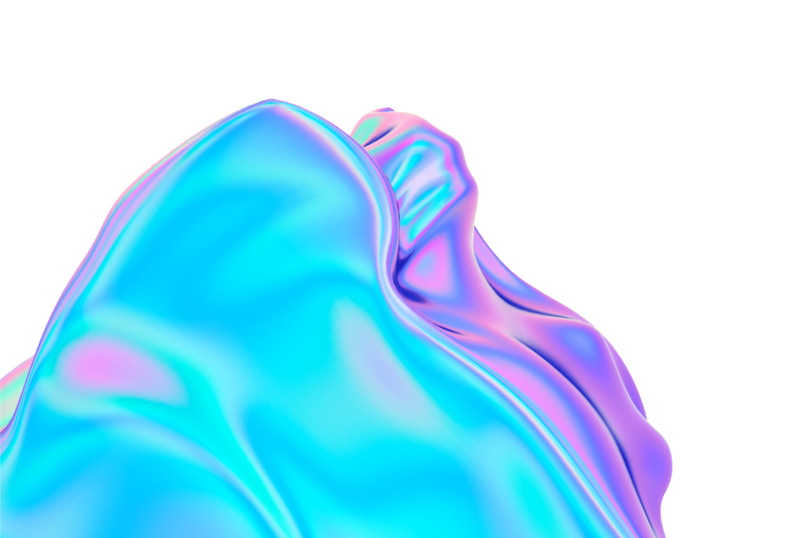
TESTING
At last we are testing the app for submission of project. By running the app in notebook.

Slide 11
MAINTENANCE
We can update our app by updating links and by rebooting the app.

Slide 12
USAGE
To start a good life healthcare is more important. Nowadays Health-care Environment has developed science and knowledge. Recently, we all have witnessed the covid pandemic that has put immense pressure on health systems all over the world and hospitals have been overwhelmed with patients, in such conditions it is very difficult to obtain the consultation with the doctor in case of any health issues. As more and more people start to use smartphones, they may provide a tool to help improve a patient's health and fitness. The proposed idea is to create a health care app system using python programming that can be used to know disease by the symptoms in a person and provide basic details about the disease before consulting a doctor. Healthcare mobile apps are becoming a reality for users. Patients are facing a problematic situation of unforeseen demise which is because of nonexistence of good medical maintenance to patients at the needed time. So we are proposing an innovative project to provide all the needed information on specific diseases from your home in case of problems. We know that there are already so many health chatbot floating around us but our app is over an idea of summarise all things together and provide a solution. It will provide you with details of the doctor concerned to your disease whom you can contact. As today covid-19 is concerned, our app provides all the needed information about the spread of corona virus, resources, data of the daily cases and necessary links of different websites at one place only. A remainder through notifications for the ease of the user, so that they can remember their medications even when they are at home or doing work and general home remedies of common diseases adds more functionality to our app and makes it one proper solution in this time of global pandemic where reaching our doctor is so difficult and maintaining a good health is necessity.

Slide 13
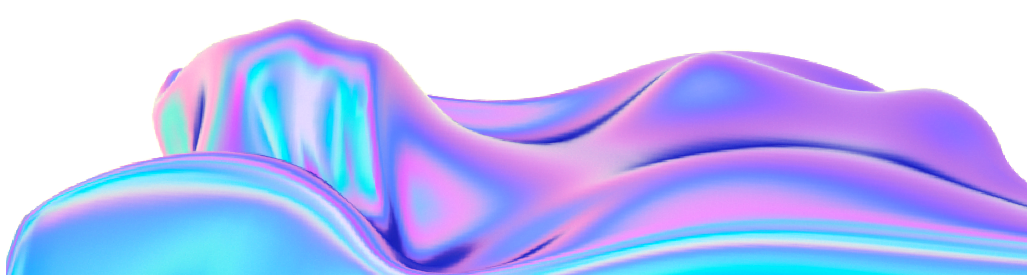
Thank You!

